Slide 1
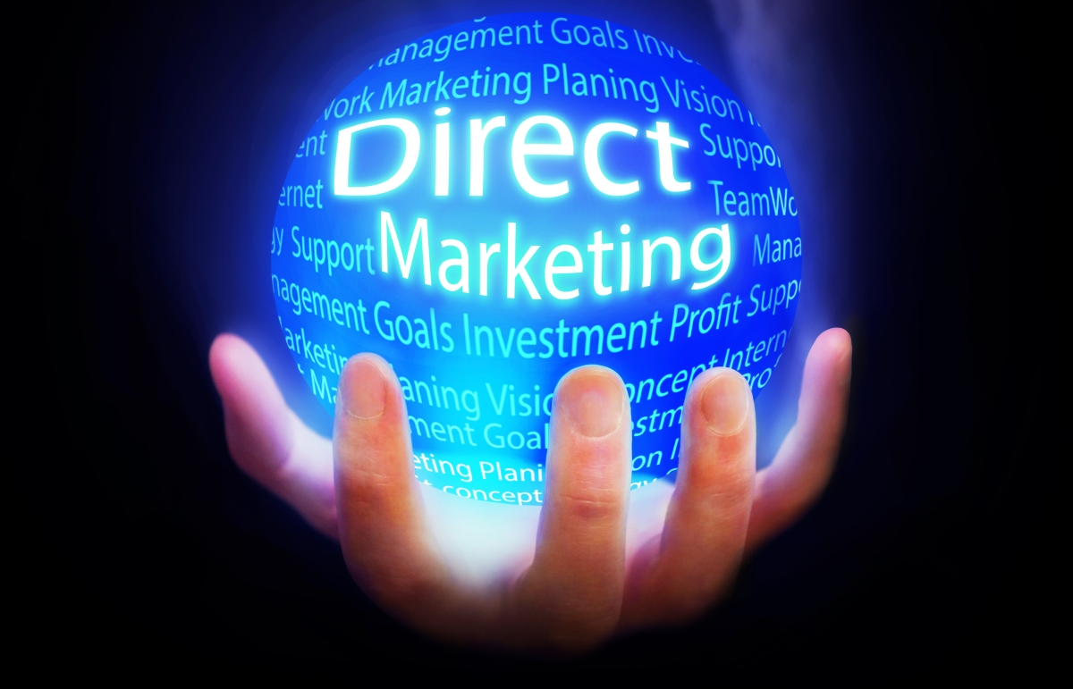
Direct Online Marketing Strategy 2024
Chillomenia Eco Couches
Olga&Nany

Slide 2
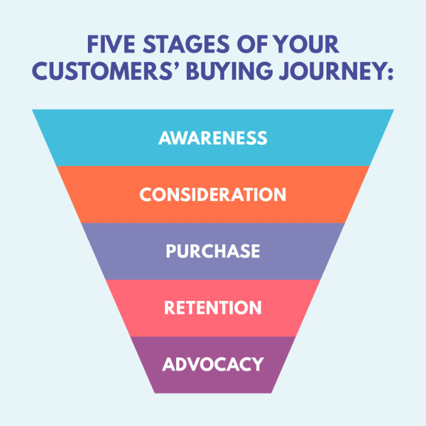
Agenda

Slide 3

Agenda
Marketing technology stack to measure results and goals

Slide 4
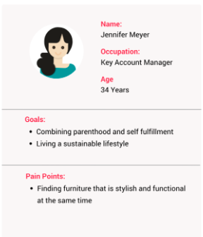
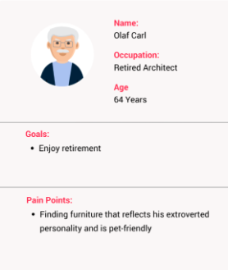
Ideal Customers Profile
Jennifer Meyer
Olaf Carl

Slide 5

Olaf Carl
Boomer.
Extroverted personality.
Offline media user.
The top social media platforms for Boomers is Facebook.

Slide 6
Customer journey Map for Olaf Carl
Awareness
They prefer Traditional offline media: Print, Radio and TV like matinee programs or prime time.
However, they are shifting towards online media: emails and Facebook.
Consideration
Communication with them should be Active Listening.
Pre sales: easy and clear information.

Slide 7
Customer journey Map for Olaf Carl
Purchase
Sales process: Support for payment methods, Invoice and guarantee.
Retention
Post sales: delivery and build process. Call them to find out what their Experience has been like.

Slide 8
Customer journey Map for Olaf Carl
Advocacy
In case of bad experiences, we should offer discounts in addition of the guarantee.
Show them that we recognize our mistakes and we are going to solve them as soon as possible.

Slide 9

Online Marketing Strategy for Olaf Carl
Online Channels: Google Search & Facebook.

Slide 10

Offline Marketing Strategy for Olaf Carl
Offline Channels: Print, Radio and TV.
Expensive and it is not possible to Track their results.
But they are the 21,97% of the population in Germany.

Slide 11

Jennifer Meyer
Jennifer is a millennial and a young parent. She wants to have a more sustainable lifestyle as well as to be a mindful consumer. Aside from that, she values style and functionality.
The top 3 social media platforms for millennials are Facebook (87%), Instagram (72%), and YouTube (66%). Online Channels: Google Search, Instagram, Facebook, Pinterest, Website, Blog

Slide 12
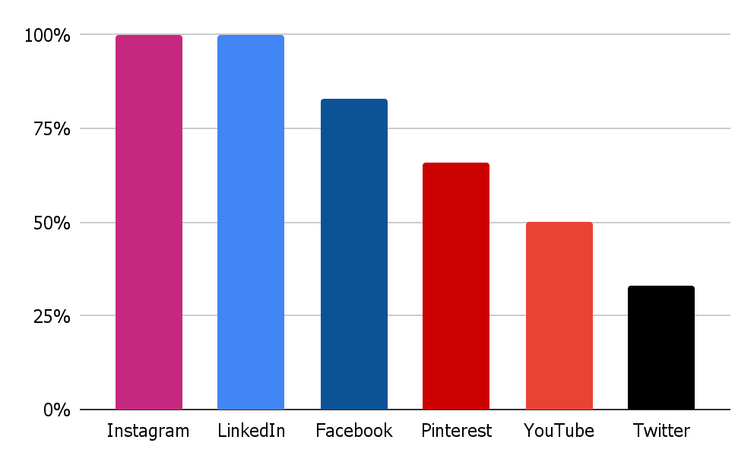
Competitors and online channels
Maiden Home
Inside Weather
Sabai Design
MOR Design
Sofa Company
Bolia

Slide 13
Competitors Online Presence Components and Incentives
Blog
Social Media Activity
Curated Collections
Virtual Showroom
Google Ads
Facebook Ads
Instagram Sponsored Posts
Free swatches
Free delivery in the EU
Bulk order discounts
Discounts & Seasonal Offers
Advertorials
Brand Collabs
Influencer Partnerships
Ambassador Program
Reviews

Slide 14
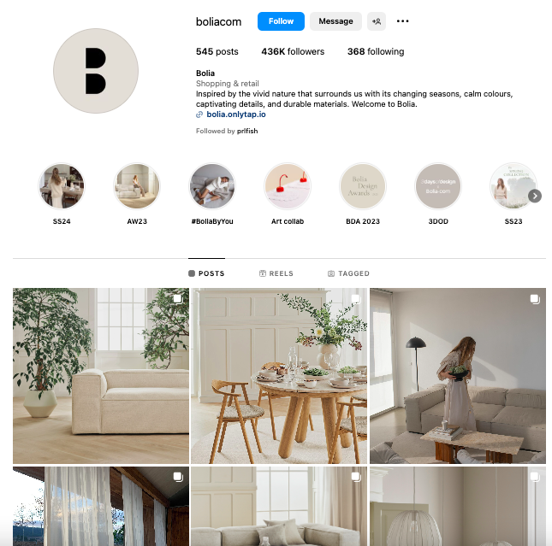
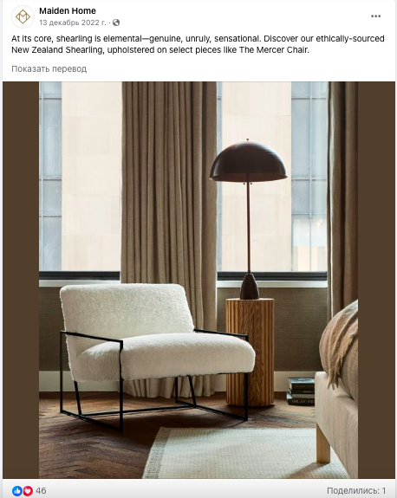
Online Presence
Instagram, Facebook, Pinterest Goal: Establish brand awareness, convey brand message, build loyalty, acquire new clients, improve market understanding Create High-quality visual content, sponsored posts, reels, collaborations, influencer marketing, announcements, user interviews, informative content

Slide 15
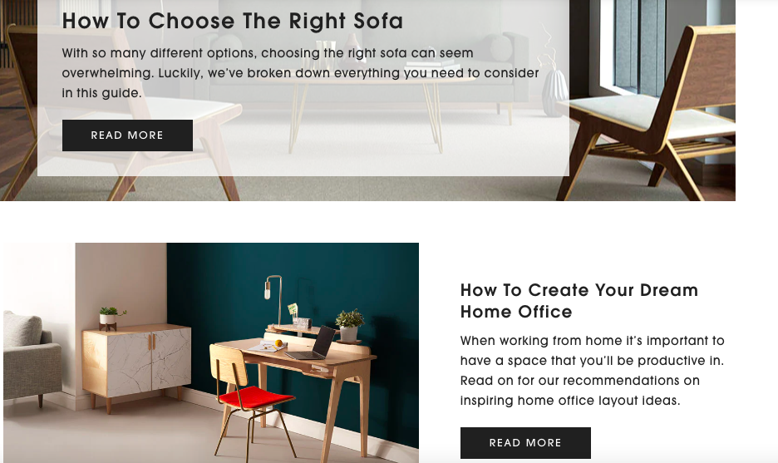
Online Presence
Blog Goal: to inform the (potential) clients about the products and services, provide useful information, broaden reach and discoverability, build a brand
We create relevant content that includes popular keywords in the niche, applying best SEO principles

Slide 16

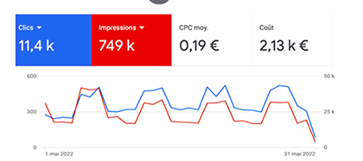
Online Presence
Paid Advertisement
Goal: Increase brand reach, increase revenue, awareness, strengthen position on the market, discover new keywords and study competitors. Tools: search ads, instagram ads, display ads, advertorials.

Slide 17
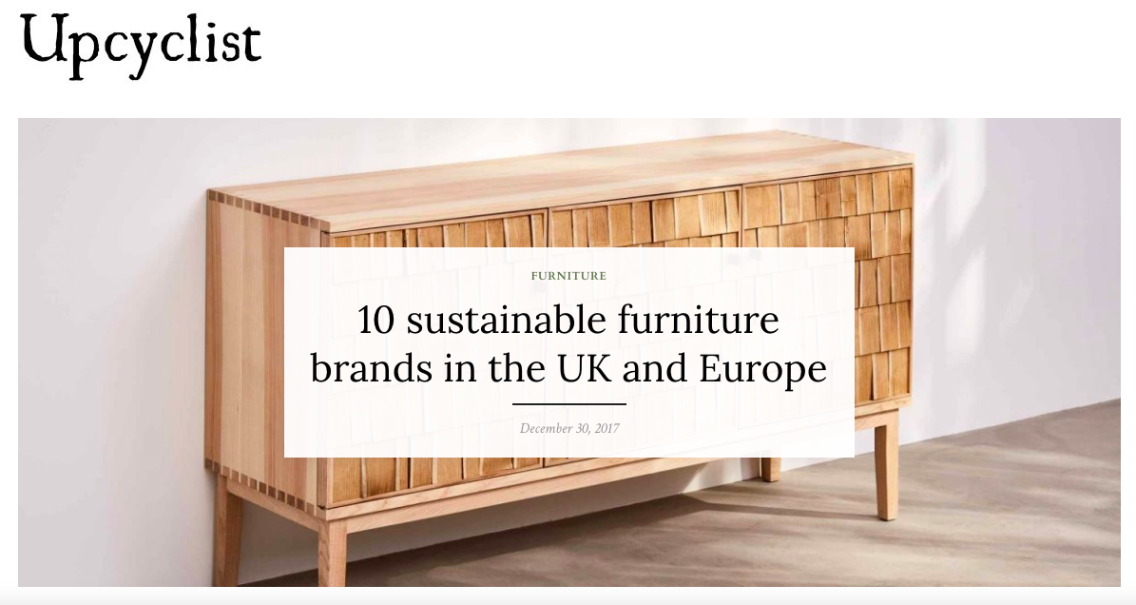
Online Presence
Collaborations & Reviews
Goal: We increase our reach and attract new clients through collaborations with distribution partners (influencers, industry platforms, affiliates etc.). We encourage customers to leave reviews on our social media channels, website, or platforms like google reviews and trustpilot. We create a reward system for them (discount coupon on next order)

Slide 18
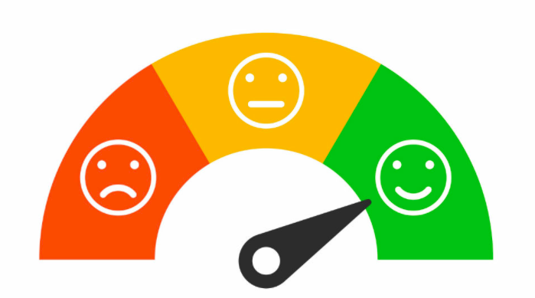
Online Presence
Exceptional Service
Goal: Increase retention, build customer loyalty, improve user experience, knock out competition
Dedicated support manager, various contact channels, feedback forms, exceeding expectations (free delivery, coupons, help with installation, handwritten notes, limited offers, free swatches and others)

Slide 19
MarTech for Chillomania
Google Analytics: understand consumers better, optimize campaigns and make better informed decisions
Google Keyword Planner: find and implement best-fit keywords in content and ads
Google Tag Manager: add and update your own tags for conversion tracking, site analytics and remarketing
CRM, ChatBot: keep track of customers and provide good support
Google Looker Studio: make reports and visualize data

